Slide 1

RAJAMAHENDRI INSTITUTE OF ENGINEERING AND TECCHNOLOGY
ELECTRONICS AND COMMUNICATION ENGINEERING
Under the Guidance of
Dr. CH. SURYABABU,
M.Tech, Ph.D.
PRESENTED BY: J. DHEERAJ 21MD1A0429
G. BHARATH CHANDU 21MD1A0422
N. SATISH CHANDRA 22MD5A0407
M. JAGADIESHESWAR 21MD1A0440

Slide 2
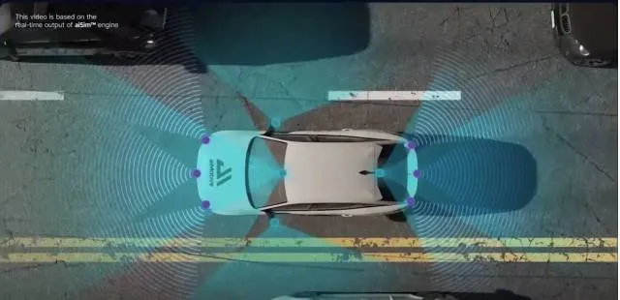
TITLE
Mean Based Approach To Omnidirectional Pathfinding Algorithm Using Single Ultrasonic Sensor for Robotic Car

Slide 3
Contents
Abstract
Introduction
Problem statement & challenges
System components
Working mechanism
Block diagram
Existing methods & limitations
Proposed method
Advantages and future scope

Slide 4
Abstract
We propose an IoT-enabled omnidirectional pathfinding system to improve real-time obstacle detection and navigation for autonomous robotic vehicles. By integrating a single ultrasonic sensor, a servo motor, L293D motor driver, and IoT-based monitoring, our system scans a 180-degree field for better detection and accuracy. Processed data from the sensor allows smooth navigation via a mean-based pathfinding algorithm. This system reduces false positives, optimizes movement, and enables remote monitoring, ideal for applications like search-and-rescue, industrial automation, and hazardous environment exploration.

Slide 5
Introduction
Pathfinding algorithms are crucial in robotics and automation for finding paths and avoiding obstacles.
Existing pathfinding algorithms for ultrasonic sensors are limited by their monodirectional nature, often relying on simple binary decisions (left and right), leading to inaccuracies.
Enhancements to these algorithms aim to improve their accuracy.
These algorithms have applications in the military to reach inaccessible or dangerous areas.

Slide 6
Problem Statement & Challenges
Problem Statement:
In modern robotics and automation, the accuracy and efficiency of pathfinding algorithms are limited by the monodirectional nature of ultrasonic sensors
Often rely on simple binary directional decisions (left and right).
inaccuracies in pathfinding and obstacle avoidance,
Challenges:
Real-time Processing.
Algorithm Enhancement.
Environmental Adaptation.
Reduce false Alarms.

Slide 7
System Components
Arduino Uno
L293D Motor Driver
Chassis
Motor & wheels
Ultrasonic Sensor HC-SR04
Servo motor
Jumper wires

Slide 8
System Components
Arduino Uno
L293D Motor Driver
Chassis
Motor & wheels
Ultrasonic Sensor HC-SR04
Servo motor
Jumper wires

Slide 9
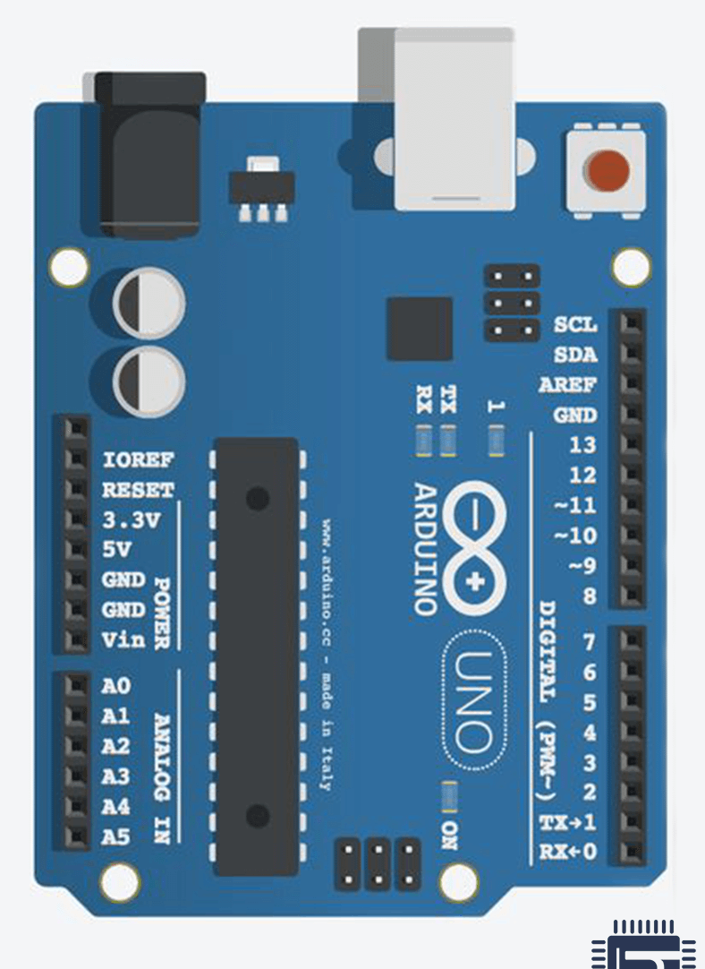
System Components
1. Arduino Uno
Digital Pins (D₀ – D₁₃)
Analog Pins (A₀ – A₅)
Power pins
V_{in} , 3.3v,5v,ioref,reset
Processor: Atmega328P
PWM pins: 3,5,6 , 9,10,11
UART PINS: D₀,D₁

Slide 10
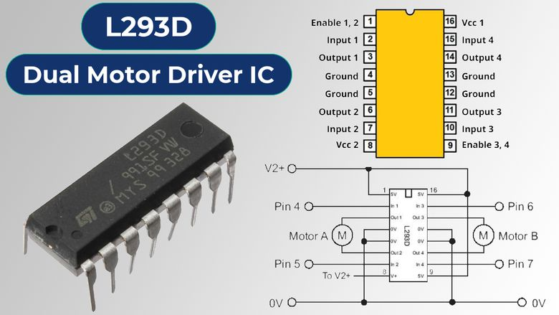
System Components
2. L293D Motor Driver
The L293D is a popular motor driver IC used to control the direction and speed of DC motors. It contains two H-bridge circuits, allowing it to control two DC motors simultaneously

Slide 11
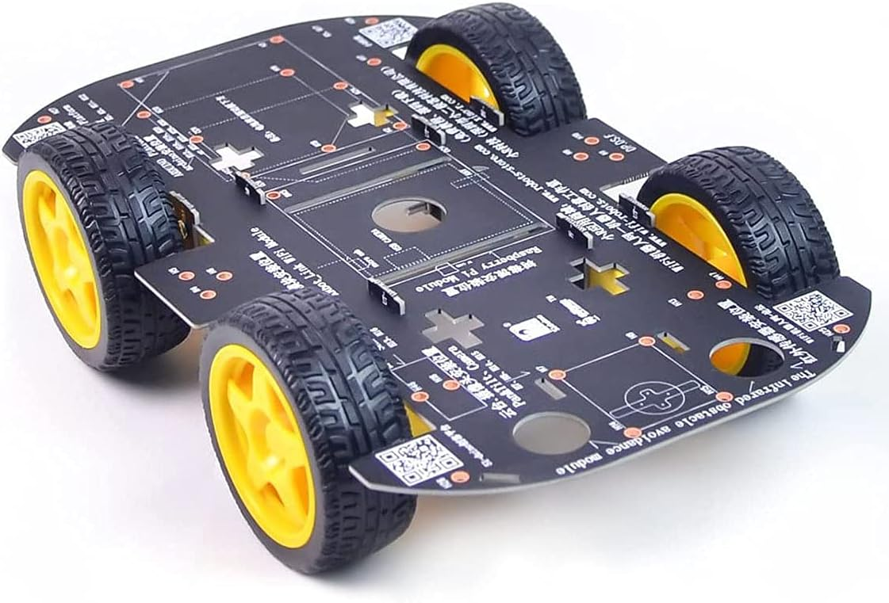
System Components
3. Chassis
The chassis is the structural framework of a vehicle, providing support for all other components, including the body, engine, and wheels. It ensures stability and strength, allowing the vehicle to function properly.

Slide 12
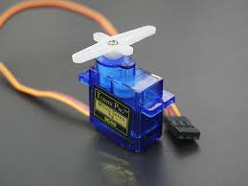
System Components
4. servo Motor
A servo motor is a rotary actuator that allows for precise control of angular position, velocity, and acceleration. It consists of a motor, a position sensor, and a control circuit. Servo motors are commonly used in robotics, automation, and control systems to perform tasks requiring precise positioning.

Slide 13
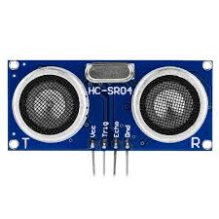
System Components
5. Ultra Sonic Sensor HC-SR104
An ultrasonic sensor is a device that uses ultrasonic waves to measure the distance to an object. It emits high-frequency sound waves and measures the time it takes for the echo to return. This information is then used to calculate the distance to the object. Ultrasonic sensors are commonly used in robotics, automation, and automotive applications for obstacle detection and distance measurement.

Slide 14
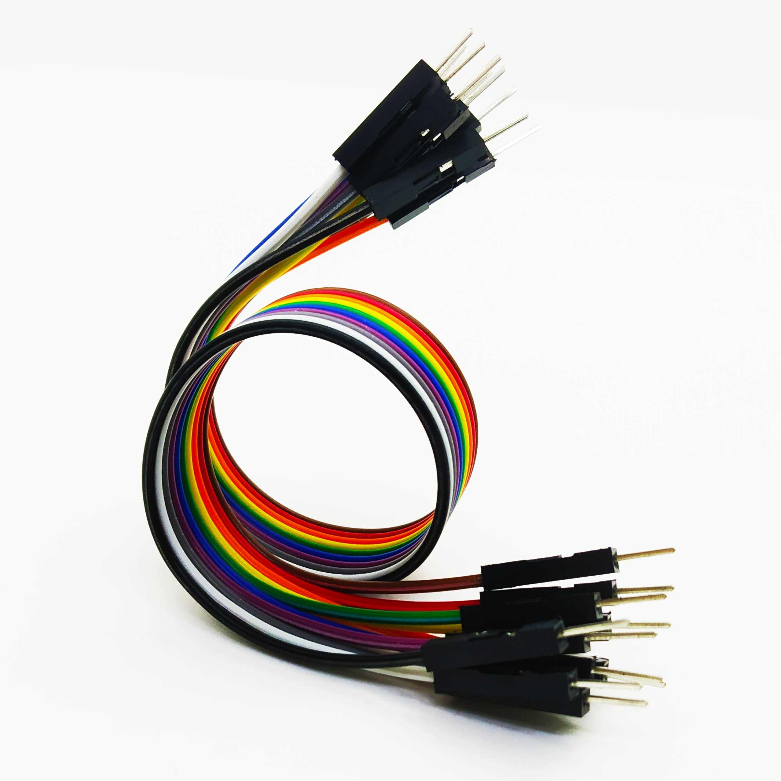
System Components
6. Jumper Wires
Jumper wires are short, flexible wires with connector pins at each end. They are used to establish electrical connections between components on a breadboard or other prototyping tools. These wires come in various lengths and colors, making it easy to create and organize circuits during prototyping and testing. They are essential for building and testing electronic projects quickly and efficiently.

Slide 15
Working Mechanism
Normal Detection Method:
Utilizes an ultrasonic sensor to measure the distance between the car and the nearest object in its line of sight.
This method is not omnidirectional, meaning it only detects objects directly in front of the sensor.
Most commonly used and does not involve the use of a servo motor
Intensive Detection Method:
Employs a servo motor to rotate the ultrasonic sensor, providing a 180-degree view for omnidirectional detection
Sensor starts at 0 degrees (extreme left) and rotates to 180 degrees (extreme right) in 3-degree steps
Collected data is analyzed to determine the subsequent actions

Slide 16
Block Diagram
Power supply
16*2 LCD
Arduino Uno
Servo motor
Ultrasonic Sensor
L293D motor driver
IOT
M1
M2

Slide 17
Existing Methods
df

